Slide 1
Code Guard Introduction

Slide 2
Code Guard Features
Intercept memory error that cannot find while compiling.
Point out the possible related code at which line that occur the error.
Generate code guard log file if a error occur when executing the program by built file.

Slide 3
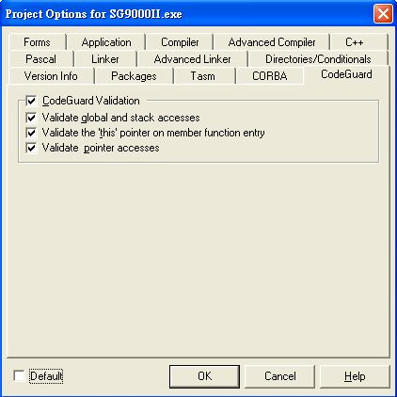
Open Code Guard Function

Slide 4
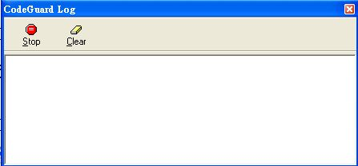
De-bug with Code Guard

Slide 5
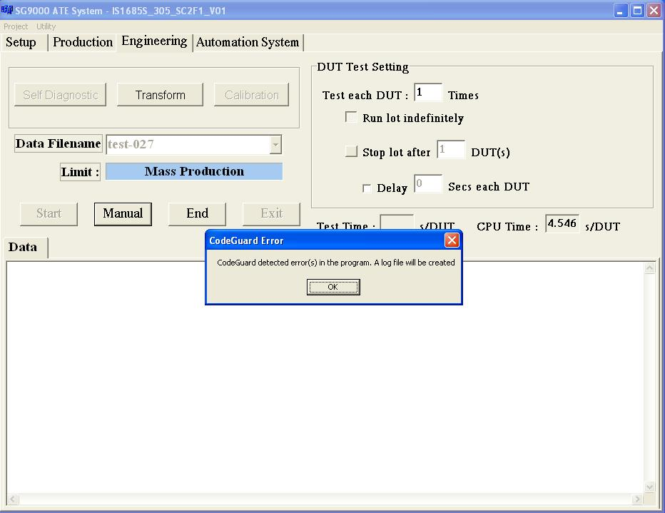

Code Guard Log File (*.clg)

